Slide 1

CLOUD BASED BUS PASS SYSTEM
Submitted by:
AAYUSHI RAI (171510003)
PRANJUL SINGHAL (171510040)
SAKSHAM JOHRI (171510046)
Guided by: Mr. Vivek Sharma
DEPARTMENT OF COMPUTER ENGINEERING AND APPLICATIONS
Institute Of Engineering and Technology
GLA University
Mathura-281406,INDIA
2019-2020

Slide 2
CONTENTS
INTRODUCTION
WHAT IS CLOUD
LANGUAGES USED
CLOUD PLATFORM USED
LIST OF FIGURES
ADVANTAGES
DISADVANTAGES
SOME GLIMPSE OF PROJECT
CONCLUSION

Slide 3
INTRODUCTION
Overview
This system was intended to develop an application for U.S.R.T.C to perform functionalities like accessing the basic information of a student from educational institutions for authentication and provide Bus pass to a particular student without placing him/her in a queue for a long time.
Online Student Bus Pass Generation system is helpful to U.P.S.R.T.C by reducing the paper work, time consumption and makes a process of getting Bus pass as simple and fast.

Slide 4
Objective
Bus pass system is a web application for students to get bus passes through online. Before this application implementation the manual process is used to do the process of issuing the bus pass to the passenger. This manual process requires man power and is more time consuming. To avoid such difficulties we implemented this system.
The key components of bus pass system is
Bus pass generation
Bus pass renewal

Slide 5
WHAT IS CLOUD
Cloud computing is the on-demand delivery of compute power, database and other IT resources via the internet with pay-as-you-go pricing.
A cloud services platform provides rapid access to flexible and low cost IT resources.
Cloud computing is a general term for anything that involves delivering hosted services over the Internet.
Example: Google Drive, Apple iCloud, Amazon Cloud Drive etc.

Slide 6
LANGUAGES USED
HTML
CSS
PHP
JAVA Script

Slide 7
CLOUD PLATFORM USED
Amazon web services
Amazon web service is a platform that offers flexible, reliable, scalable, easy-to-use and cost-effective cloud computing solutions.
The platform is developed with a combination of infrastructure as a service (IaaS), platform as a service (PaaS) and packaged software as a service (SaaS) offerings.

Slide 8
AWS Compute Service: Storage
EC2(Elastic Compute Cloud) - EC2 is a virtual machine in the cloud on which you have OS level control. You can run this cloud server whenever you want.
AWS Lambda — This AWS service allows you to run functions in the cloud. The tool is a big cost saver for you as you to pay only when your functions execute.
Amazon S3 or Amazon Simple Storage Service is a service offered by AWS that provides object storage through a web service interface. Amazon S3 uses the same scalable storage infrastructure that Amazon.com uses to run its global e-commerce network.

Slide 9
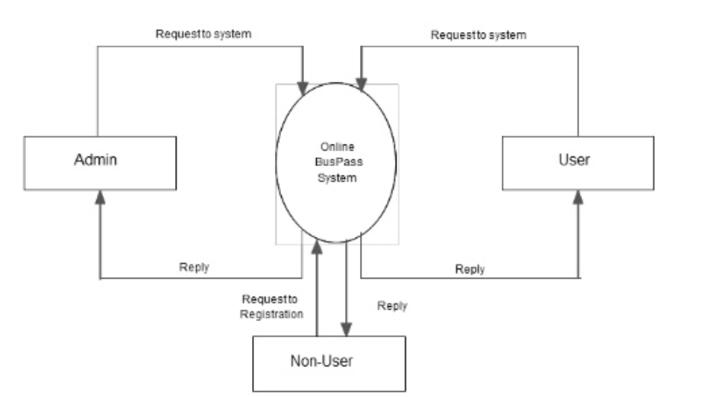
LIST OF FIGURES
Context Level DFD

Slide 10
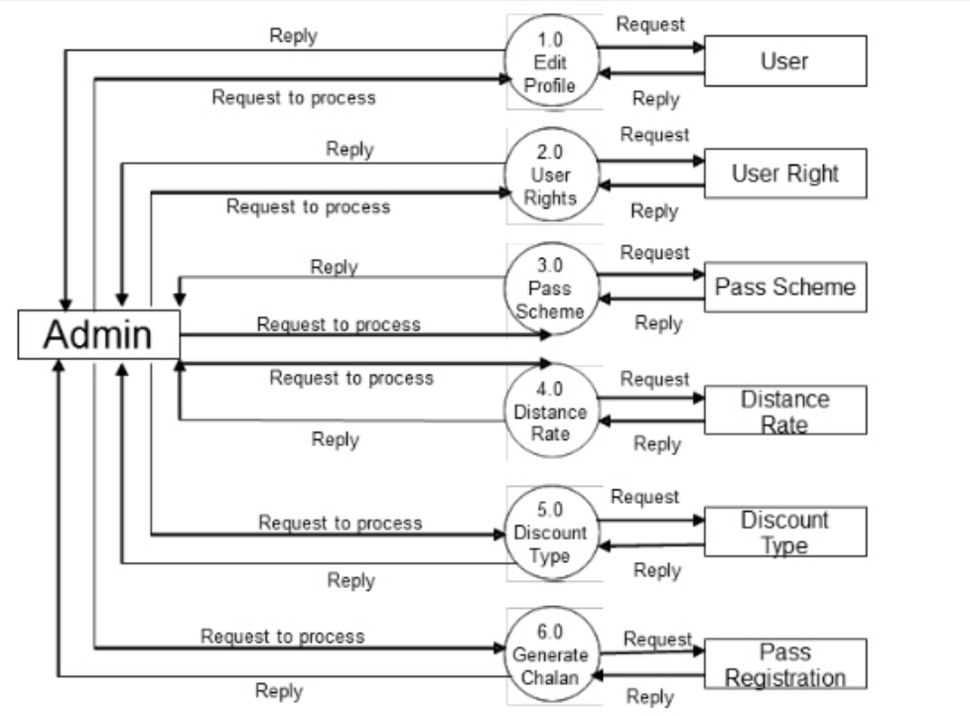
User Side: 1 level DFD

Slide 11
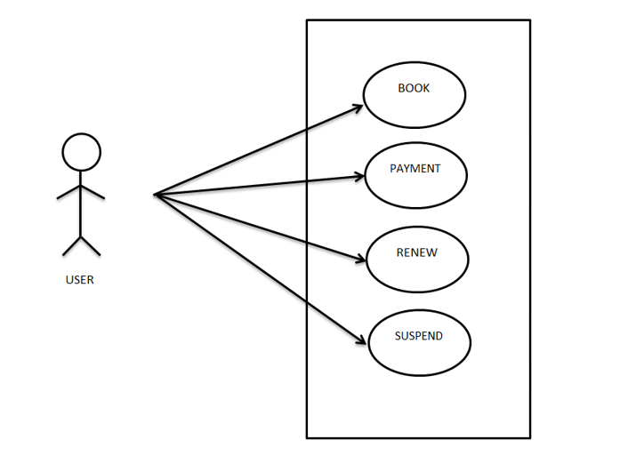
Use Case Diagram for User

Slide 12
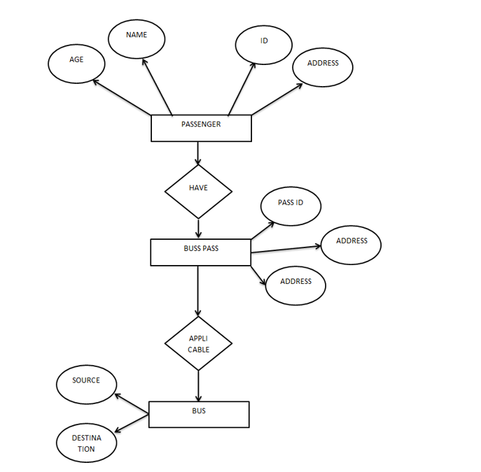
ER Diagram

Slide 13
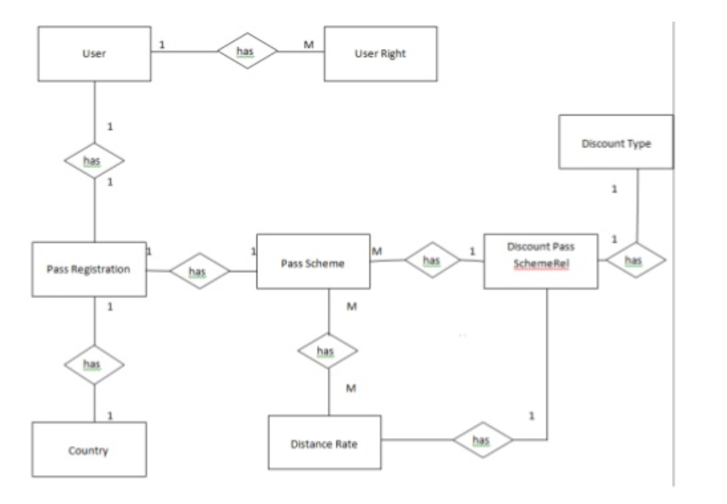
ER Diagram

Slide 14
ADVANTAGES
Passengers don’t have to waiting time in queue.
Its mostly used for most of the employers.
Information is accurate.
It is a fast process.

Slide 15
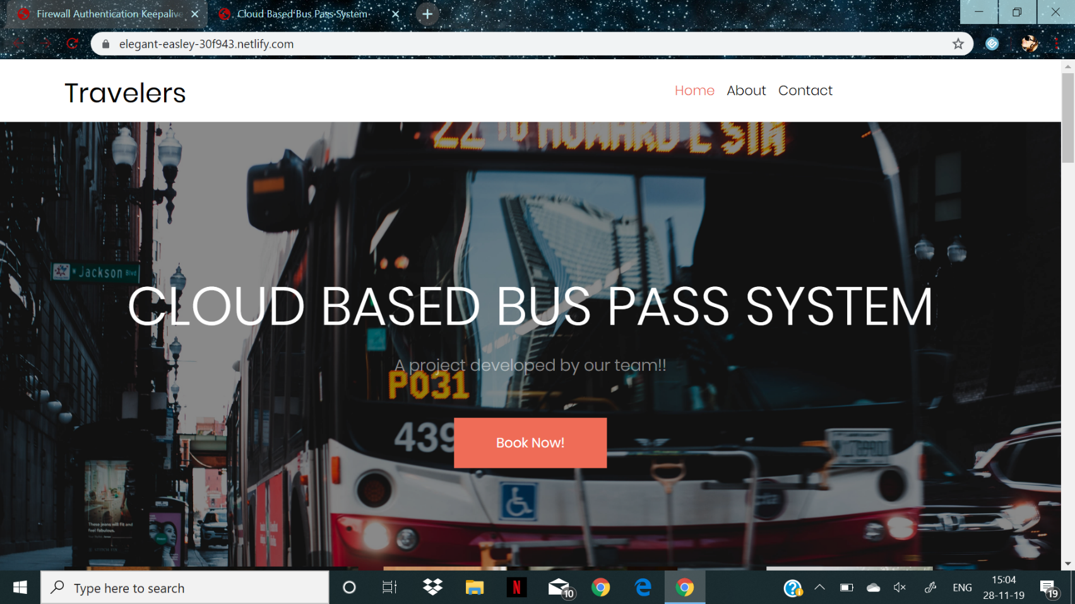
GLIMPSE OF PROJECT
Front Page

Slide 16
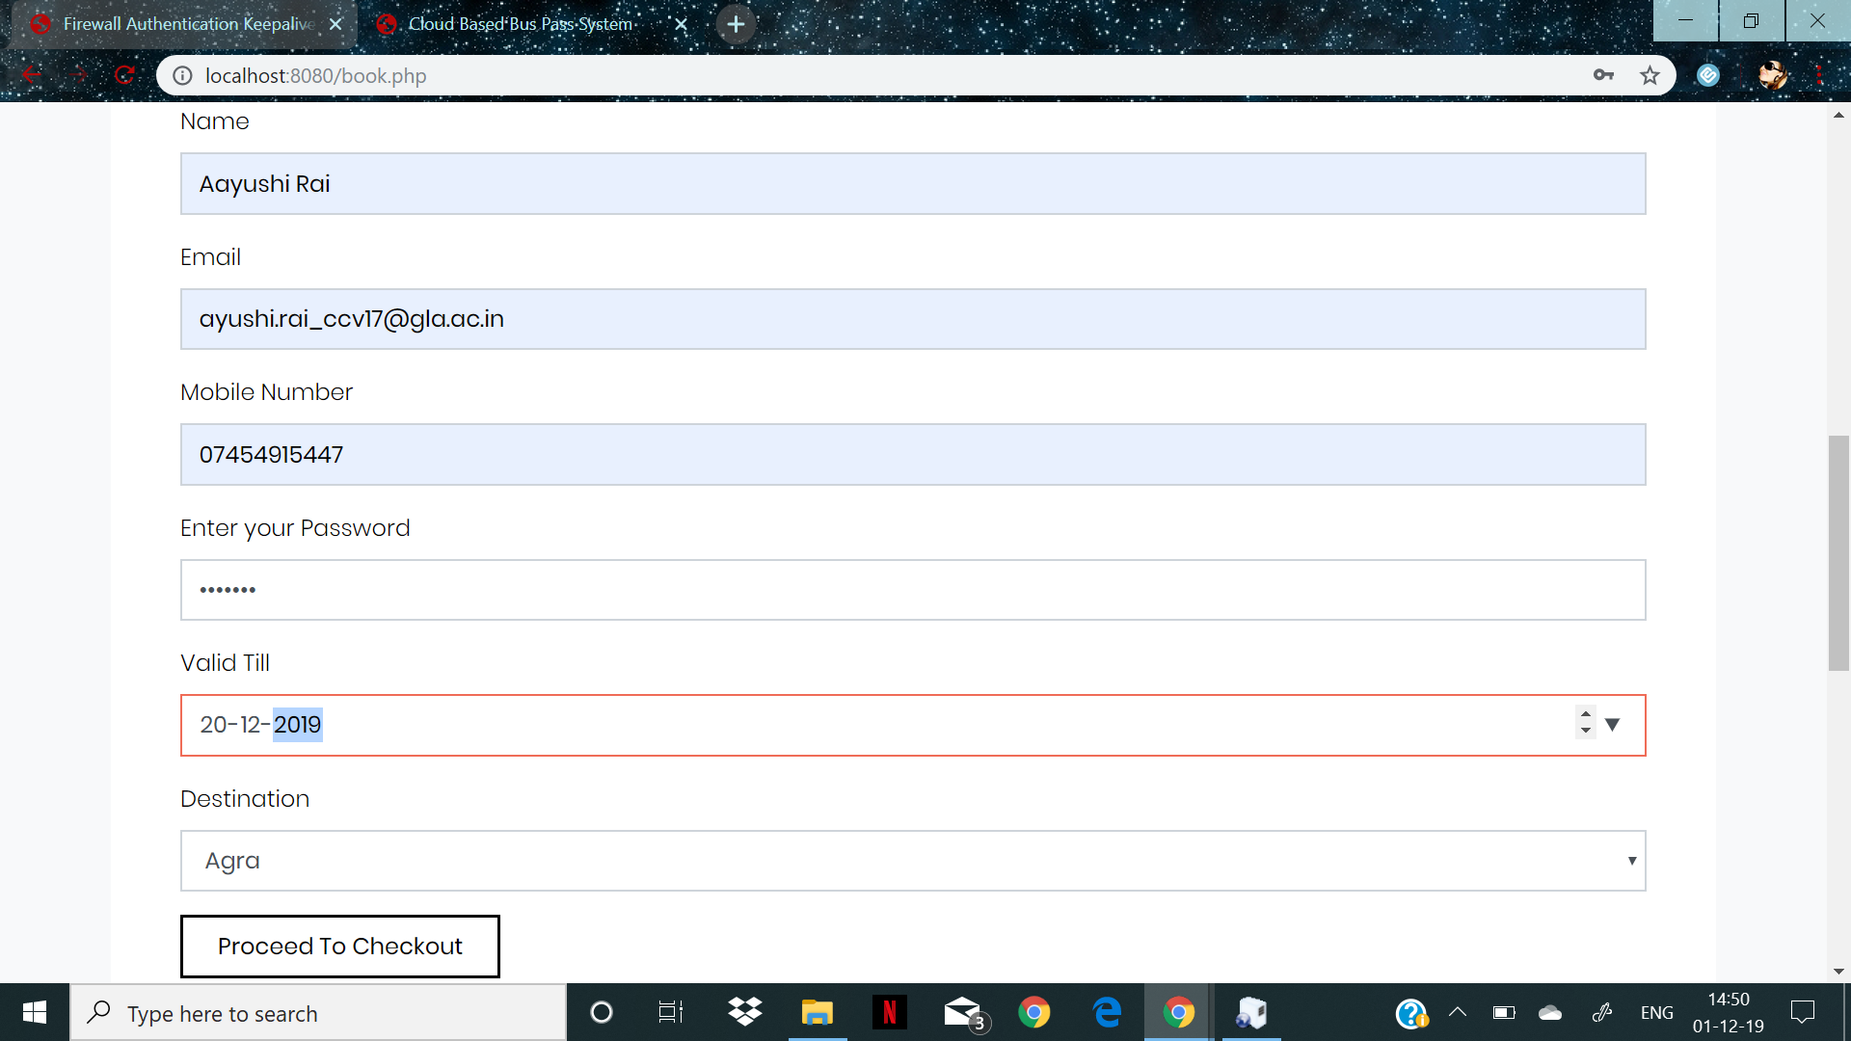
Registration Form

Slide 17
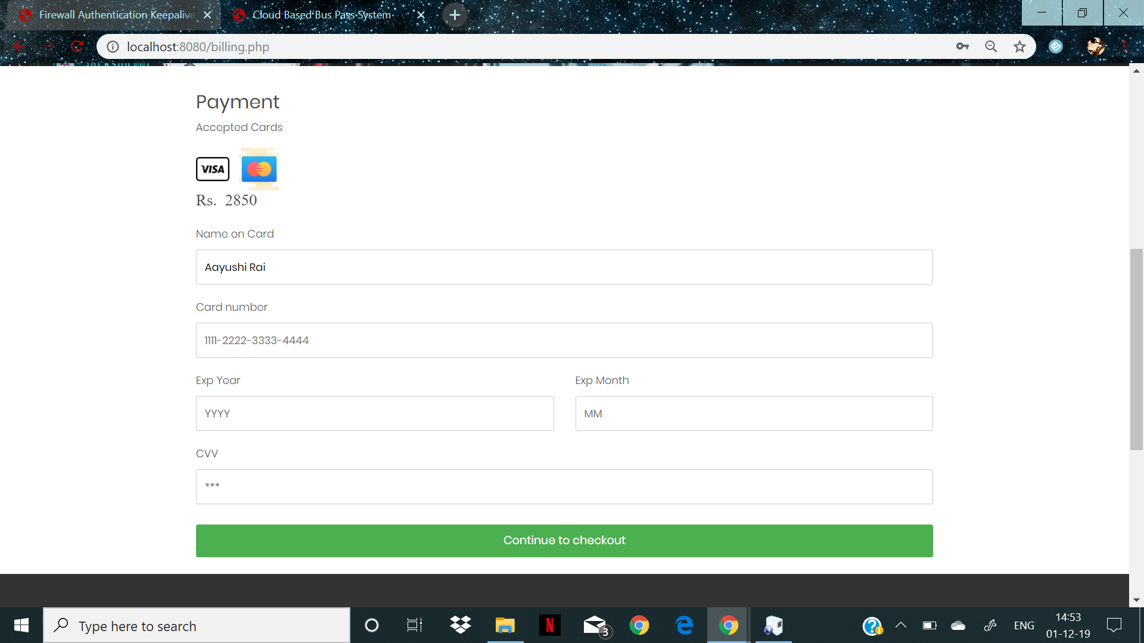
Payment Form

Slide 18
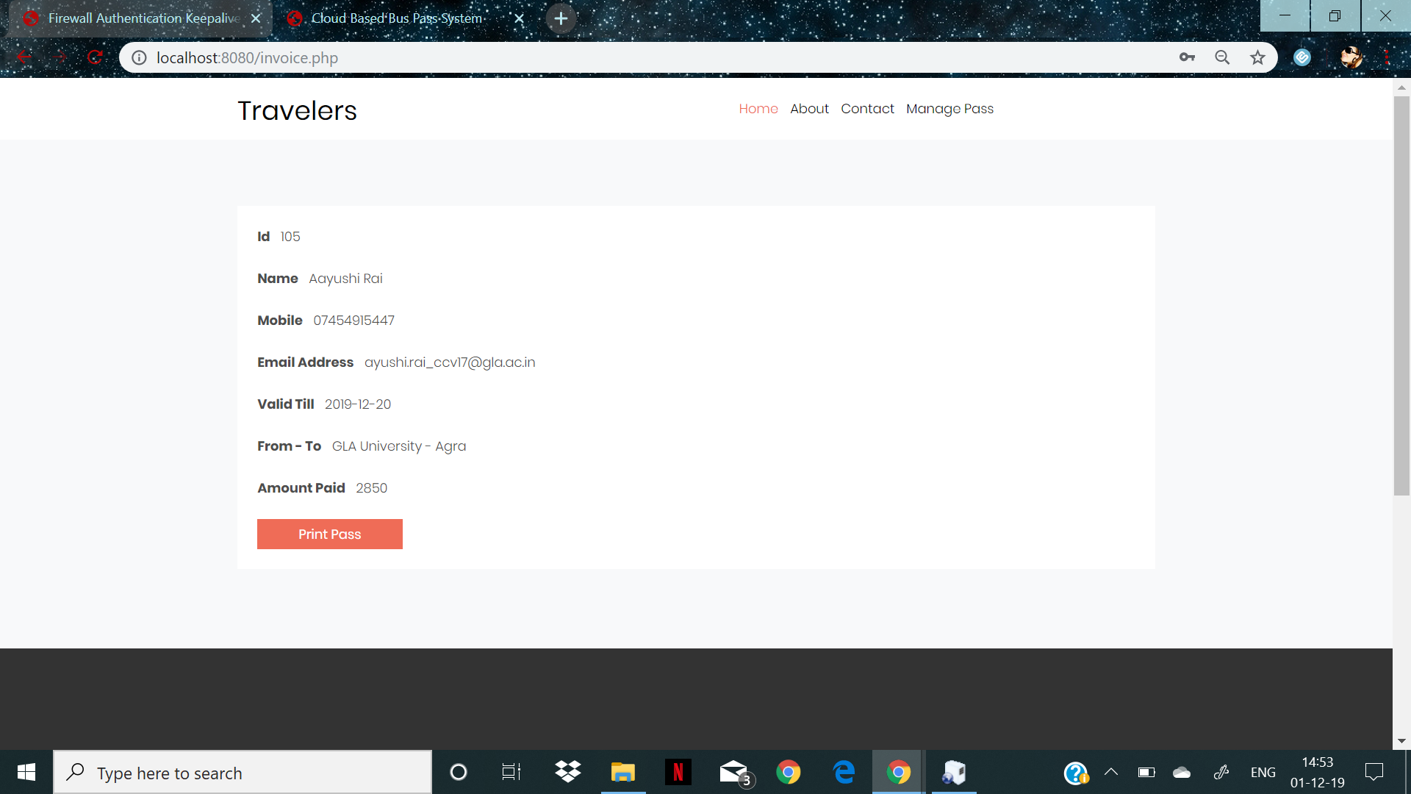
Printing The Pass

Slide 19
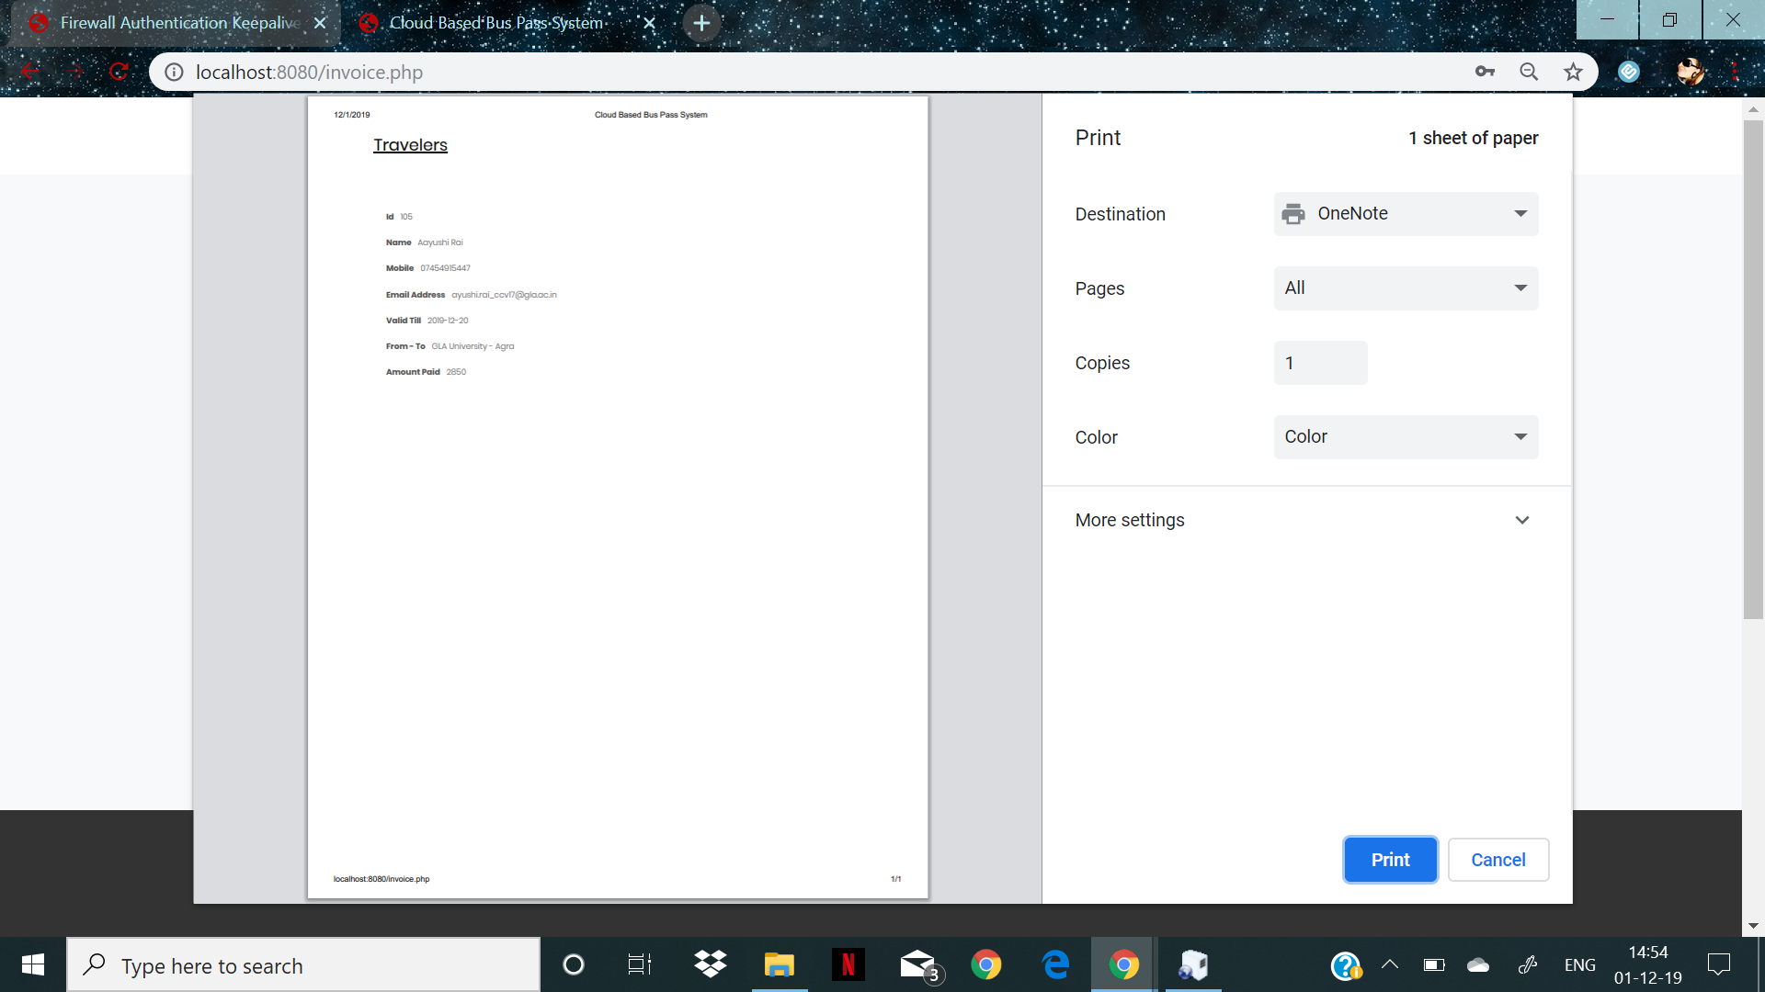

Slide 20
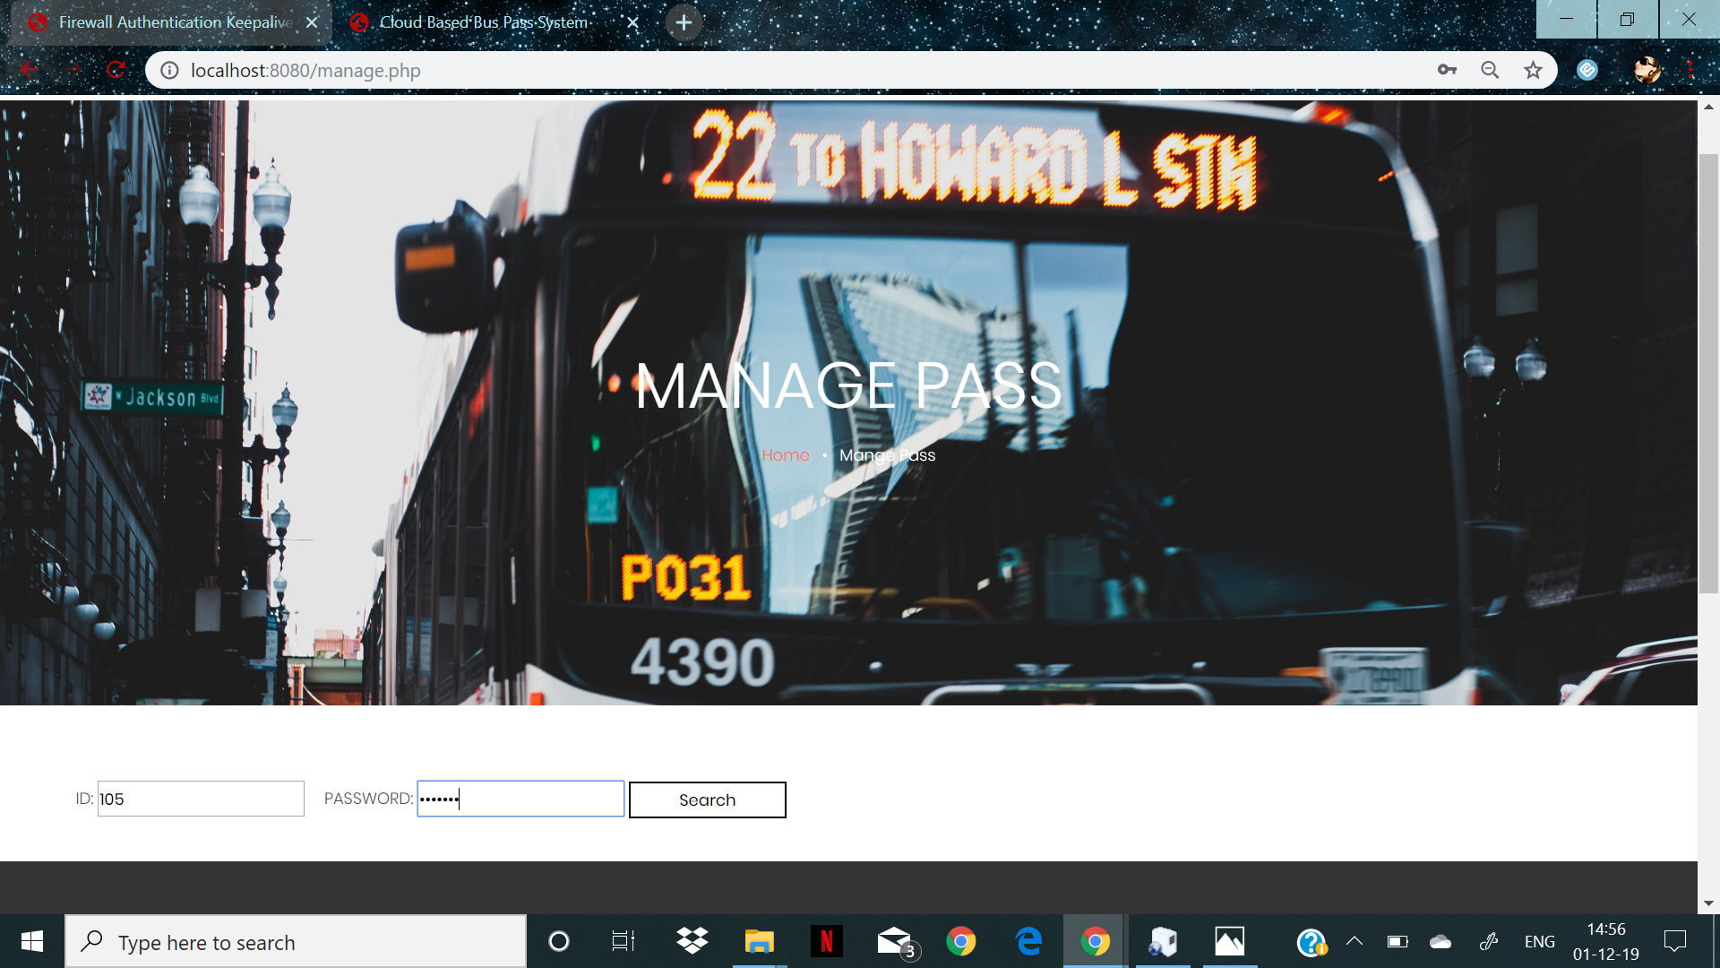
Managing the Pass

Slide 21
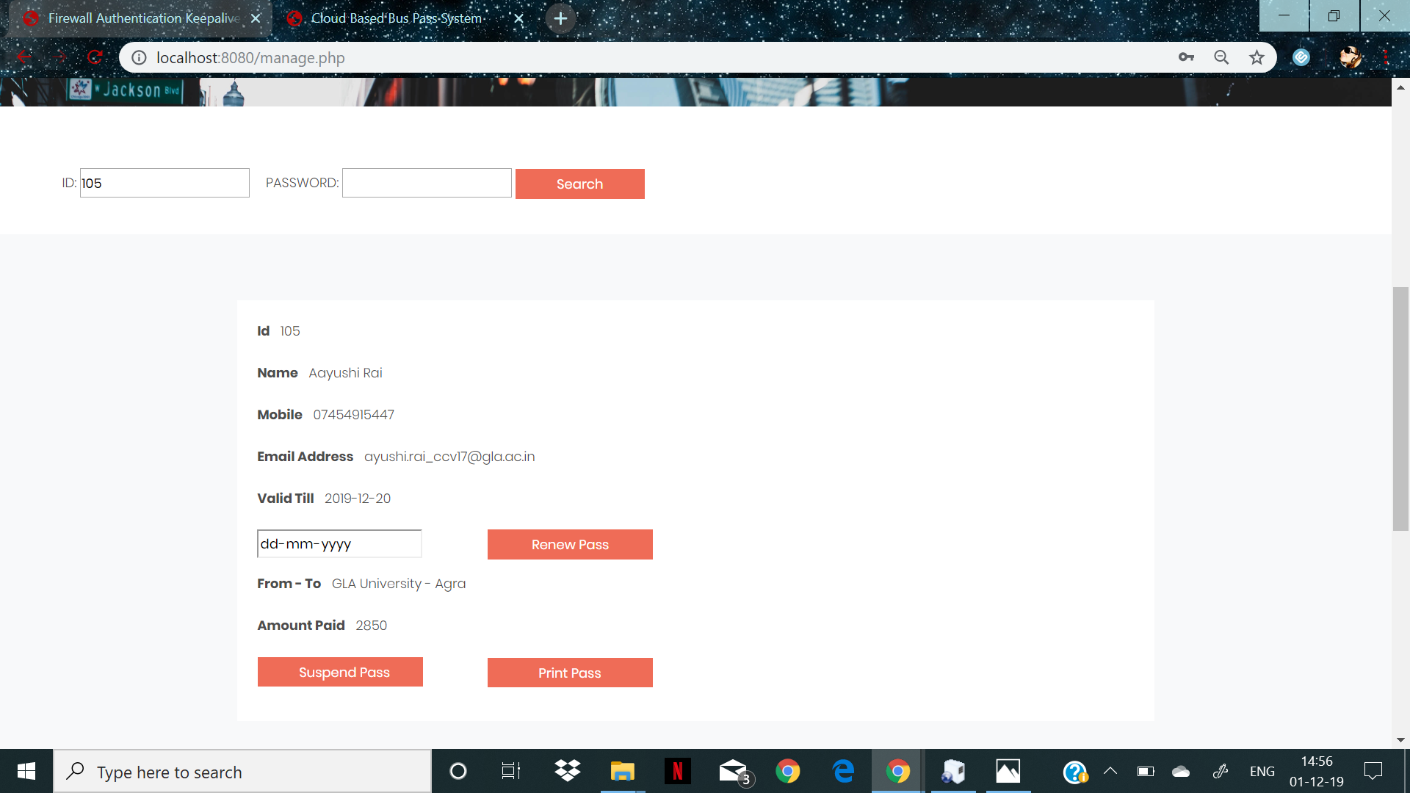

Slide 22
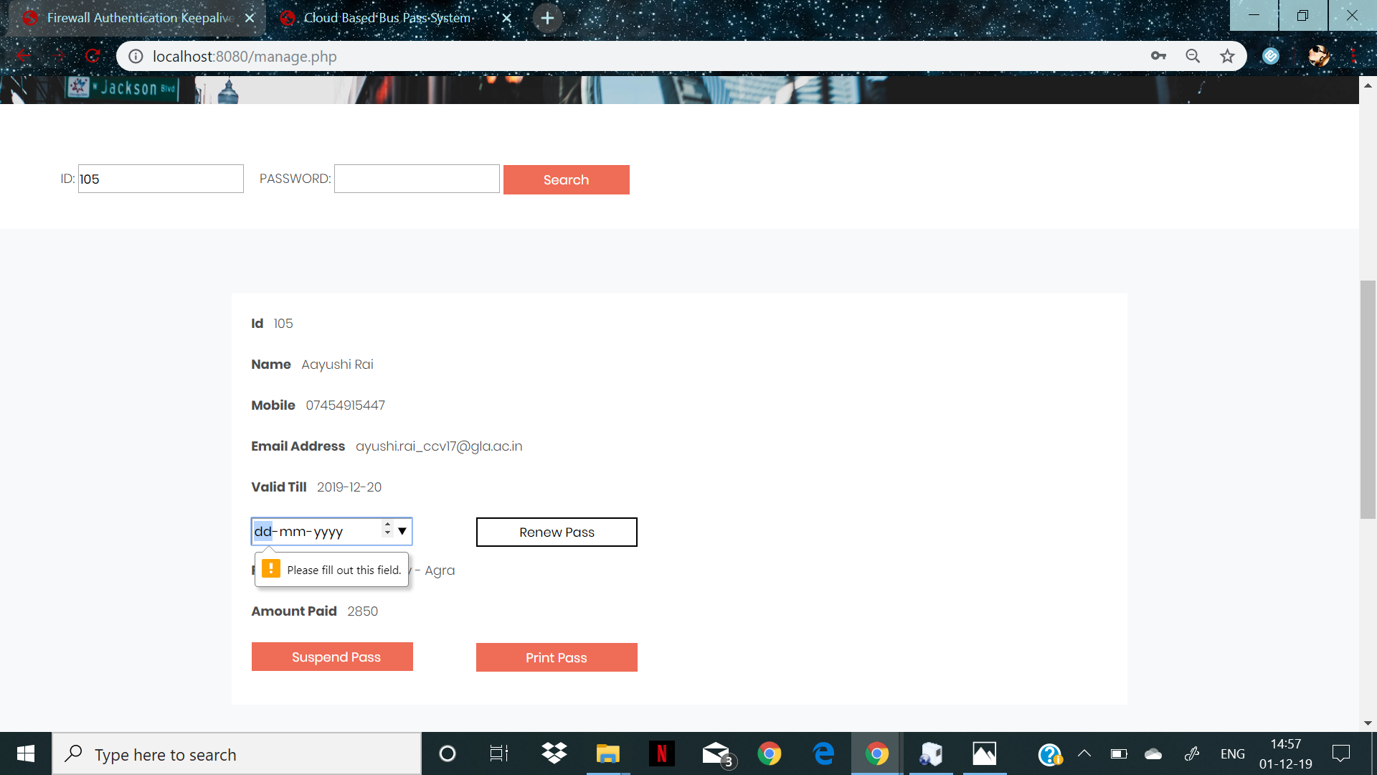

Slide 23
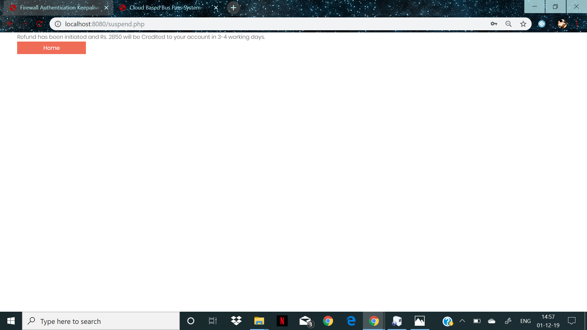

Slide 24
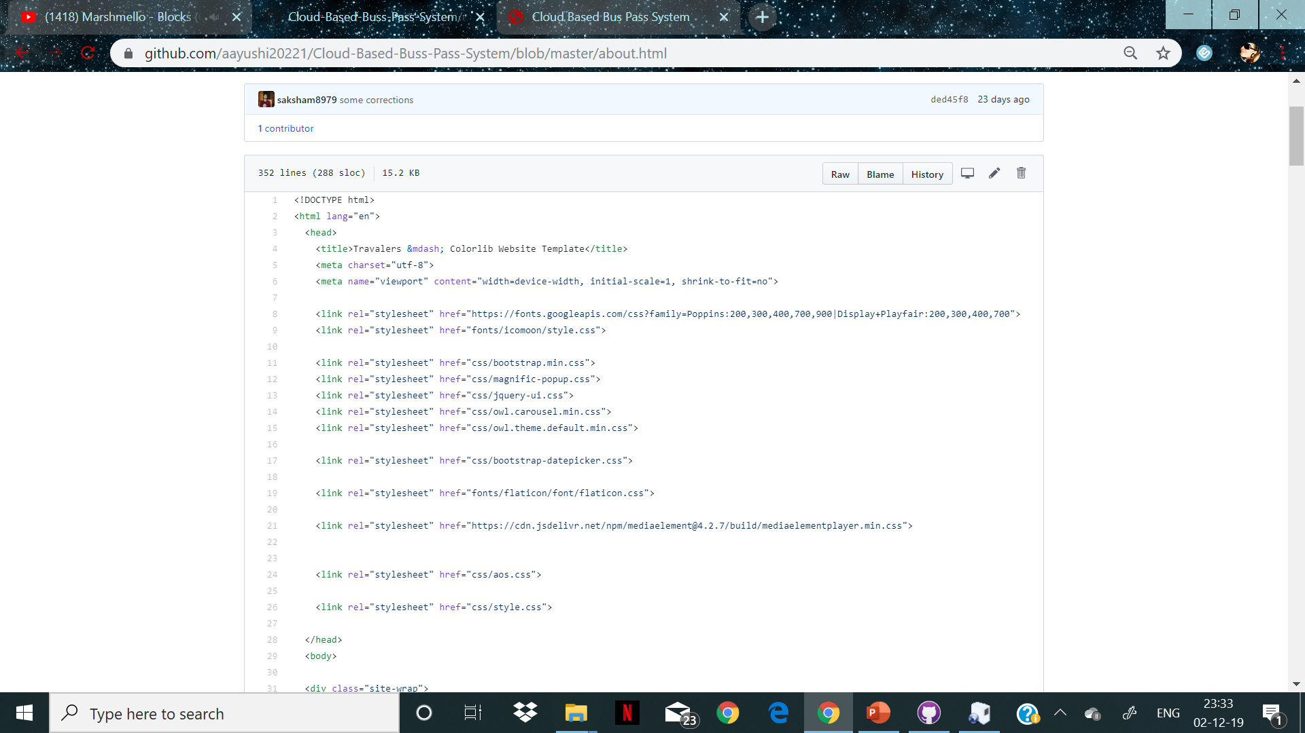
SOURCE CODE

Slide 25
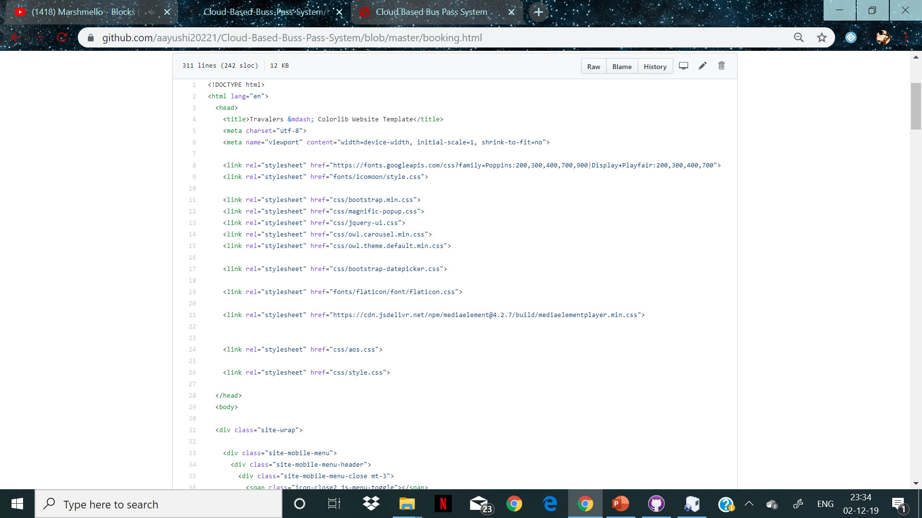

Slide 26
CONCLUSION
Bus pass Registration and Renewal System Project is a real time project which is useful for the people who are facing problems with the current manual work of bus pass Registration and renewal. It also increases the validity period, frequently Warns to the student before completion of his validity period by website. His / Her Renewal or Registration can be done using a voucher or even by a credit card.
This online bus pass registration application will help students save their time and renewal bus passes without standing in a line for hours near counters. Initially people need to register with the application by submitting details of photo, address proof, and required details and submit through online. They will verify your details and if they are satisfied they will approve bus pass. You can even renewal using credit card or other wire transfer methods.

Slide 27
REFERENCES
www.w3schools.com
https://www.geeksforgeeks.org
https://www.tutorialspoint.com
www.quora.com
www.stsckoverflow.com
www.nevonprijects.com
www.slideshare.net
www.academis.edu

Slide 28
THANK YOU

